Slide 1

Tom C. Rawlings
Interim Director

Slide 2
USDA CIVIL RIGHTS TRAINING
Prepared by : The State of Georgia
Purpose: USDA Civil Rights Training
Date: Federal Fiscal Year 2020

Slide 3
Civil Rights Compliance Training
FNS Instructions 113-1
Civil Rights Compliance and Enforcement
Nutrition Program Activities

Slide 4

Purpose
The purpose of this Civil Rights instruction is to establish and convey policy and provide guidance and direction to the United States Department of Agriculture (USDA) Food and Nutrition Service (FNS) and its recipients and customers, and ensure compliance with and enforcement of the prohibition against discrimination in TEFAP and all FNS nutrition programs and activities, whether federally funded in whole or not.

Slide 5
Protected Classes
Program benefits and participation are made available without regard to:
Race
Color
National Origin
Age
Sex
Disability
Gender Identity
Religion
Reprisal
Political Beliefs
Martial Status
Familial or Parental Status
Sexual Orientation
Public Assistance Income
Protected Genetic Information in employment, program or activity conducted or funded by the Department

Slide 6
Public Notification
TEFAP State or local agencies and their sub-recipients must have a public notification system
The Purpose of this system is to inform applicants, participants and potentially eligible persons of:
  Program availability (including dates, times and locations of CSFP distributing agencies)
  Program rights and responsibilities
  Policy of non-discrimination
  Policy for filing a complaint

Slide 7

Language Assistance
State agencies, local agencies or other sub-recipients are required to provide access to TEFAP services to Limited English Proficiency (LEP) persons and participants
Take reasonable steps to assure access is provided

Slide 8
Reasonable Accommodation for
Persons with Disabilities
Americans with Disabilities Act
Section 504 of the Rehabilitation Act of 1973
7CFR part 15b
  Prohibits discrimination of the basis of disability in all services, programs, activities provided to the public by state and local governments. Reasonable accommodations that do not cause undue hardships.

Slide 9
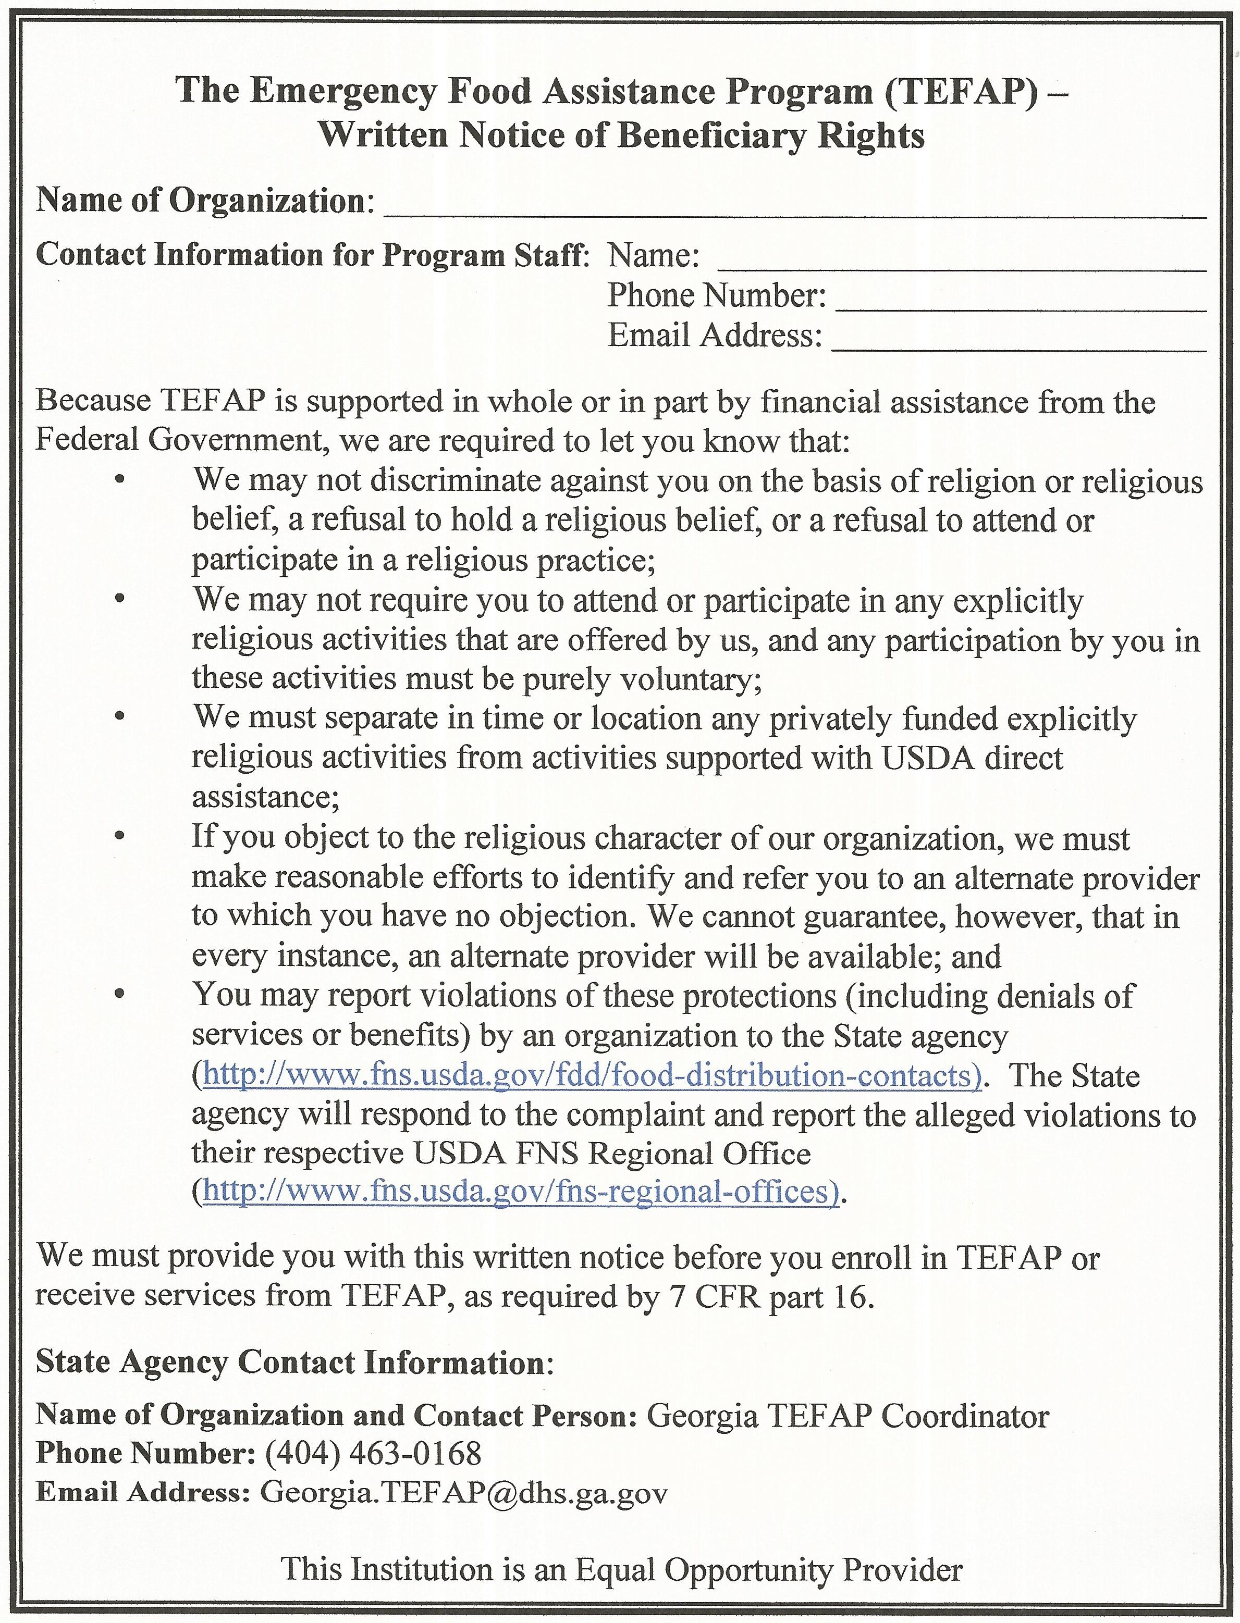
Written Notice of Beneficiary Rights
This letter must be prominently displayed at all religious based (or appear to be religious based) organizations so that participants can see it at the point where services are rendered

Slide 10
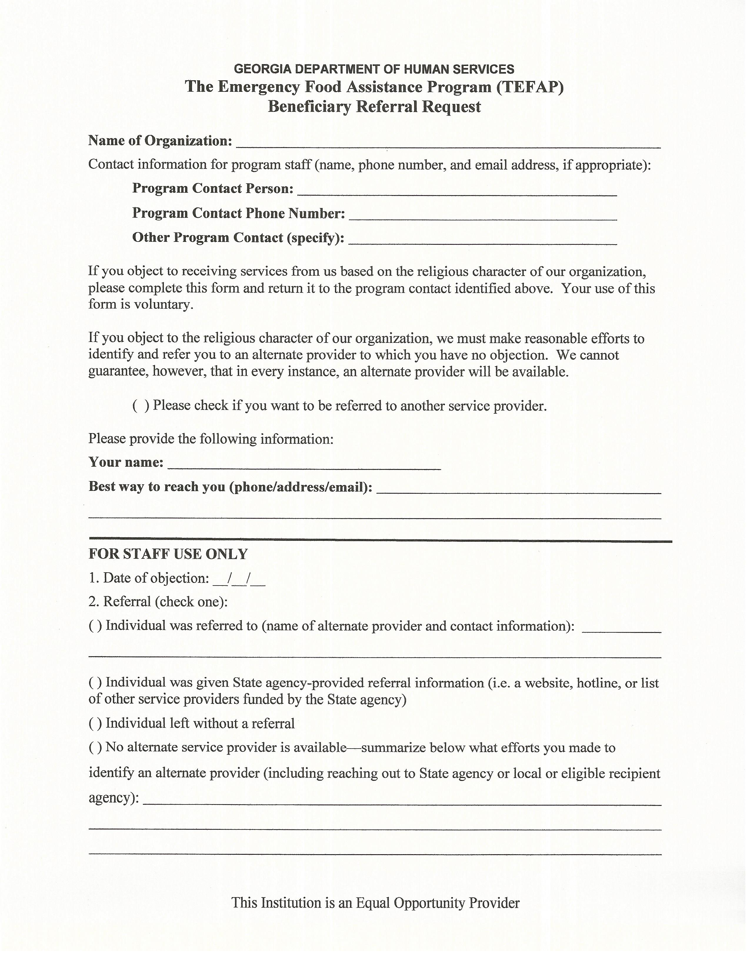
Beneficiary Referral Request
If a potential participant feels uncomfortable receiving services at a religious agency (or agency appearing to be religious), complete this form for referral to a secular food pantry for services

Slide 11
Assurances
To qualify for federal financial assistance, an application must be accompanied by a written assurance that the entity to receive financial assistance will be operated in compliance with all non-discrimination laws, regulations, instructions, policies, and guidelines
FNS will obtain a written assurance from each state agency and will ensure that state agencies obtain assurances from recipient/partner agencies
A civil rights assurance must be incorporated in all agreements between state agencies and local agencies

Slide 12

Compliance Reviews
State agency review local agencies
Local agencies review their sub-recipients
State agency must report significant findings to the reviewed entity and FNS

Slide 13
Resolution of Noncompliance
Definition of “Noncompliance”
A factual finding that any civil rights requirement, as provided by law, regulation, policy, instruction, or guidelines, is not being adhered to by a state agency, local agency or sub-recipient.

Slide 14
To Achieve Voluntary Compliance
Provide immediate written notice to the local agency or sub-recipient indicating:
    The areas of noncompliance, and
    The action required to correct the situation
Negotiate with the local agency or sub-recipient to achieve compliance

Slide 15
Complaints of Discrimination
“ In accordance with Federal civil rights law and U.S. Department of Agriculture (USDA) civil rights regulations and policies, the USDA, its Agencies, offices, and employees, and institutions participating in or administering USDA programs are prohibited from discriminating based on race, color, national origin, sex, disability, age, or reprisal or retaliation for prior civil rights activity in any program or activity conducted or funded by USDA. Persons with disabilities who require alternative means of communication for program information (e.g. Braille, large print, audiotape, American Sign Language, etc.), should contact the Agency (State or local) where they applied for benefits. ”

Slide 16
Collection and Use of Data
State and local agencies are required to obtain data by race and ethnicity
Verification of information is the preferred method of obtaining data
Applicants/Participants cannot be required to provide information regarding their race or ethnicity
When and applicant/participant does not provide this information, the collector shall, through visual observation, obtain and record the data

Slide 17

Complaint Process Rights
Right-To-File: anyone who feels discriminated against has the right to file a complaint within 180 day of the alleged discriminatory act
Acceptance: any complaint – written or verbal – must be forwarded to the State Agency according to the steps below

Slide 18
Complaint Process
Make sure you understand the person’s concern
Record details of the incident leading to the complaint, documenting the date, time, parties involved, and the issue in detail
Try to reconcile the issue
If unable to reconcile, give the individual a document with the non-discrimination statement on it, refer them to the “And Justice for All” poster and explain their right to file a complaint
Notify the state TEFAP coordinator immediately. Follow-up with an email with the details. Send to TEFAP Coordinator and Georgia.TEFAP@dhs.ga.gov
Notes:
Civil rights complaints are very serious. Many times, the complainant may misunderstand processes and procedures, however, their concern is valid and must be processed according to established procedures

Slide 19
Complaints of Discrimination
Individuals who are deaf, hard of hearing or have speech disabilities may contact USDA through the Federal Relay Service at (800) 877-8339.
Additionally, program information may be made available in languages other than English.
To file a program complaint of discrimination, complete the USDA Program Discrimination Complaint Form, (AD-3027) found online at: http://www.ascr.usda.gov/complaint_filing_cust.html, and at any USDA office, or write a letter addressed to USDA and provide in the letter all of the information requested in the form.
To request a copy of the complaint form, call (866) 632-9992.

Slide 20
Complaints of Discrimination must be reported by:
Mail:
U.S. Department of Agriculture, Office of the Assistant Secretary for Civil Rights, 1400 Independence Avenue, SW, Washington, D.C. 20250-9410;
Fax:
(202) 690-7442;
or
Email:
program.intake@usda.gov.

Slide 21

The code of Quality Customer Service
Always:
Smile and Be Pleasant
Treat Everyone with Respect and Courtesy
Be Caring and Understanding
Be a Good Listener
Offer Assistance
Serve Clients in A Timely Manner
Apologize for Any Inconvenience
Make Clients Feel Appreciated

Slide 22
Civil Rights Training
All levels of TEFAP and CSFP administration must receive Civil Rights training
The SDA will train the food bank. The food bank must train the recipient/partner agencies and other “front-line” staff who interact with program applicants or recipients
Maintain documents after training is performed (i.e. sign-in sheets of attendees, agenda, etc.)

Slide 23
Civil Rights Training Topics
Specific subject matter required, but not limited to:
Effective public notification systems
Requirements for language assistance
Requirements for reasonable accommodations of persons with disabilities
Compliance review techniques
Resolution of noncompliance
Complaint procedures
Conflict resolution
Customer service

Slide 24
For Additional Civil Rights Compliance Information
Contact:
TEFAP Coordinator
Business Operations Specialist
(404) 463-8042
Georgia Department of Human Services
DFCS/OFI/FANU/TEFAP
2 Peachtree St. NW, Suite 21
Atlanta, GA 30303

